Slide 1
CUSTOMER PRODUCT RECOMMENDATION SYSTEM

Slide 2
SECTIONS
INTRODUCTION
DATASET OVERVIEW
EXPLORE DATA
DATA PREPROCESSING
FEATURE ENGINEERING
CORRELATION ANALYSIS
DIMENSIONALITY REDUCTION
MODELING
MODEL EVALUATION & ANALYSIS
RECOMMENDATION SYSTEM

Slide 3
Introduction
INTRODUCTION
DATASET OVERVIEW
EXPLORE DATA
DATA PREPROCESSING
FEATURE ENGINEERING
CORRELATION ANALYSIS
DIMENSIONALITY REDUCTION
MODELING
MODEL EVALUATION & ANALYSIS
RECOMMENDATION SYSTEM
Problem Statement
Objectives

Slide 4
Problem statement
Problem : Improve product recommendations from each group customer behaviors.
Goal :
creating new features
build a clustering model

Slide 5
Objectives
The objectives of the project are as follows
Data Cleaning & Transformation
Feature Engineering
Data Preprocessing
Customer Segmentation using K-Means Clustering
Cluster Analysis & Evaluation
Recommendation System

Slide 6
DATASET OVERVIEW
INTRODUCTION
DATASET OVERVIEW
EXPLORE DATA
DATA PREPROCESSING
FEATURE ENGINEERING
CORRELATION ANALYSIS
DIMENSIONALITY REDUCTION
MODELING
MODEL EVALUATION & ANALYSIS
RECOMMENDATION SYSTEM

Slide 7
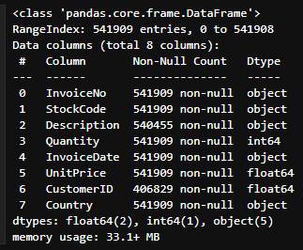
Dataset source : https://archive.ics.uci.edu/dataset/352/online+retail
Dataset size : 541,909 rows and 8 columns
Features of Dataset :
InvoiceNo : invoice number for each transaction
StockCode : the product code for each item
Description : descriptions of the products
Quantity : quantity of products purchased in each transaction
InvoiceDate : records the date and time of each transaction
UnitPrice : price of each product
CustomerID : customer's ID
Country : country where each transaction occurs

Slide 8
EXPLORE data
INTRODUCTION
DATASET OVERVIEW
EXPLORE DATA
DATA PREPROCESSING
FEATURE ENGINEERING
CORRELATION ANALYSIS
DIMENSIONALITY REDUCTION
MODELING
MODEL EVALUATION & ANALYSIS
RECOMMENDATION SYSTEM

Slide 9
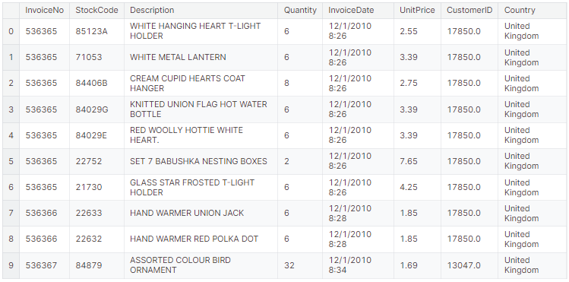
First 10 rows of dataframe

Slide 10
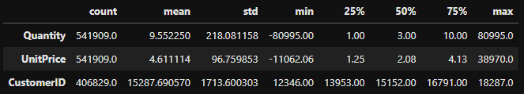
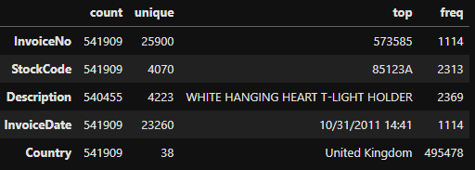
SUMMARY STATISTICS
Numerical variable
Categorical variable

Slide 11
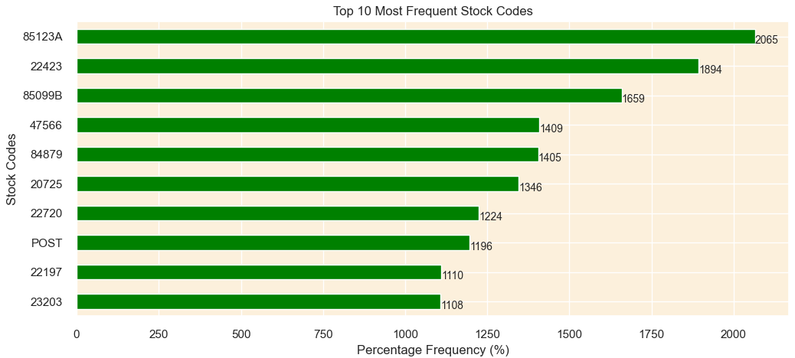
TOP 10 MOST FREQUENT STOCK CODES

Slide 12
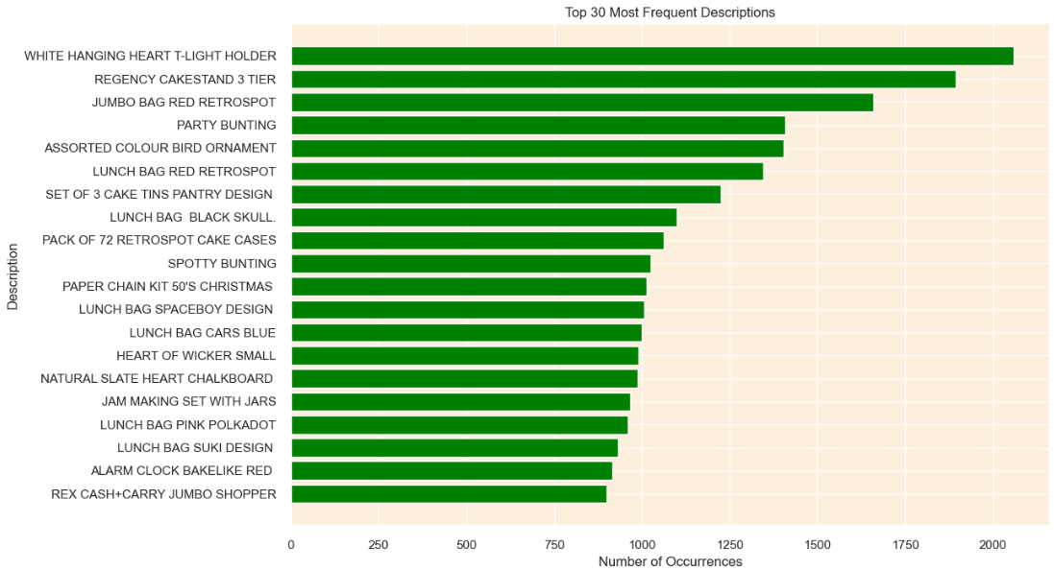
TOP 30 MOST FREQUENT descriptions

Slide 13
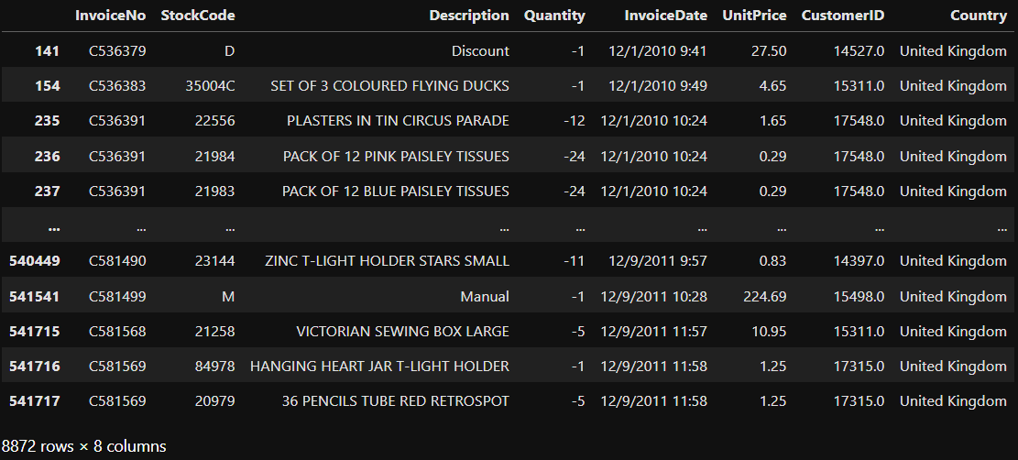
Show all canceled transaction
From below dataframe, there are total 8,872 transaction are cancelled
these transactions by filtering the rows where the InvoiceNo starts with "C".

Slide 14
DATA PREPROCESSING
INTRODUCTION
DATASET OVERVIEW
EXPLORE DATA
DATA PREPROCESSING
FEATURE ENGINEERING
CORRELATION ANALYSIS
DIMENSIONALITY REDUCTION
MODELING
MODEL EVALUATION & ANALYSIS
RECOMMENDATION SYSTEM
4.1 Handling Missing Values
4.2 Handling Duplicate Values
4.3 Handling Cancelled Transactions
4.4 Correct StockCode Anomalies
4.5 Cleaning Description
4.6 Treating Zero Unit Prices

Slide 15
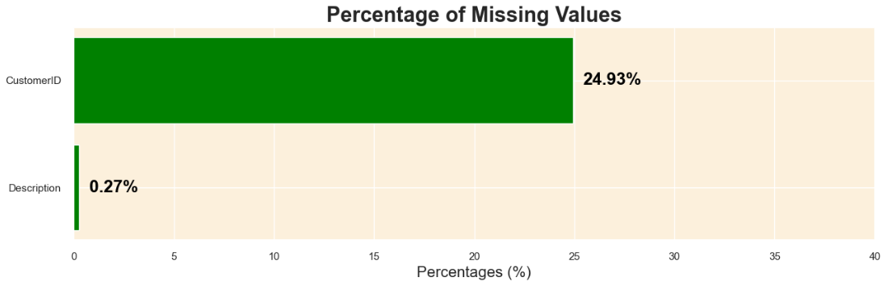
4.1 HANDLING MISSING VALUES

Slide 16


HANDLING missing value strategy
CustomerID (24.93% missing values)
- The CustomerID column contains nearly a quarter of missing data. This column is essential for clustering customers and creating a recommendation system. Imputing such a large percentage of missing values might introduce significant bias or noise into the analysis.
Description (0.27% missing values)
- The Description column has a minor percentage of missing values. However, it has been noticed that there are inconsistencies in the data where the same StockCode does not always have the same Description. This indicates data quality issues and potential errors in the product descriptions.
By removing rows with missing values in the CustomerID and Description columns, we aim to construct a cleaner and more reliable dataset, which is essential for achieving accurate clustering and creating an effective recommendation system.

Slide 17
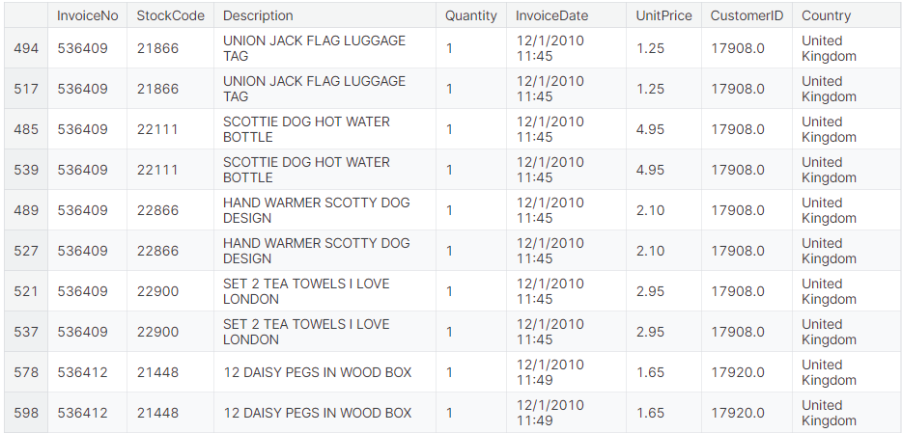
4.2 HANDLING DUPLICATE VALUES

Slide 18
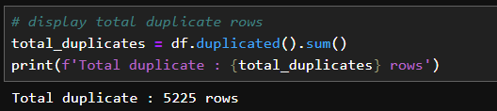
HANDLING DUPLICATES strategy
There are 5225 dulplicates rows, the presence of completely identical rows, including identical transaction times, suggests that these might be data recording errors rather than genuine repeated transactions.
Keeping these duplicate rows can introduce noise and potential inaccuracies in the clustering and recommendation system.
Removing these rows will help in achieving a cleaner dataset, which in turn would aid in building more accurate customer clusters based on their unique purchasing behaviors.

Slide 19
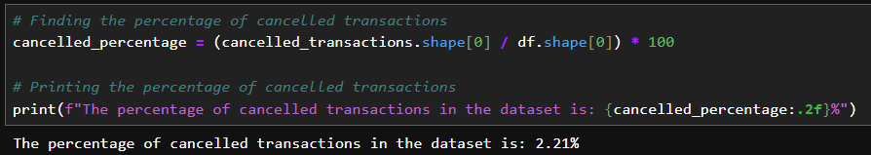
4.3 HANDLING cancelled transaction
We know that there are total 8,872 cancelled transactions from data exploration
The percentage of total transactions in the dataset 2.21 %
Strategy for handling cancelled transactions
The project's objective to cluster customers based on their purchasing behavior and create a recommendation system.
Therefore, the strategy is to retain these cancelled transactions in the dataset, marking them distinctly to do further analysis.

Slide 20
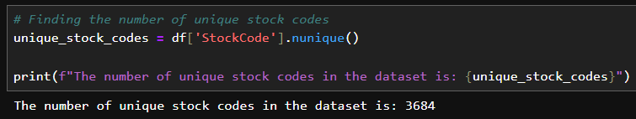
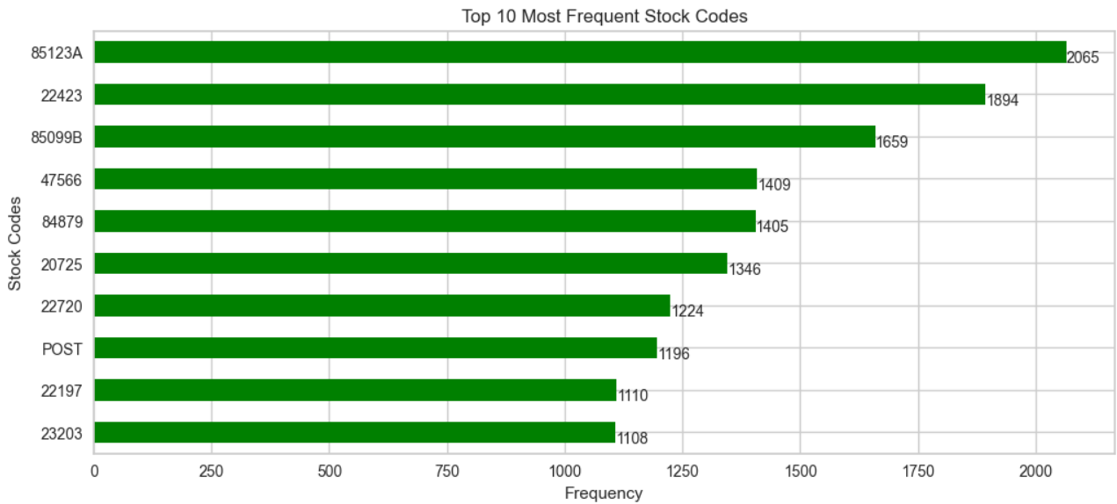
4.4 HANDLING STOCKCODE ANOMALIES
There are 3,684 unique stock codes
Top 10 most frequent stock codes

Slide 21
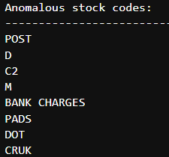
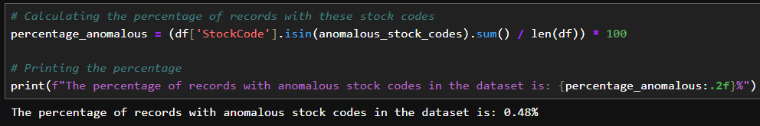
All types of anomalous stock codes
There are 0.48 % of anomalous stock codes in the datasets
Strategy for handling stock code anomalies
From the previous visualization, we observed that those anomalious stockcodes did not
represent actual products and contains very small amount in the dataset.
including them in the analysis might create a noise and affect to the clustering and
recommendation system.
Hence, we will remove the row that included has stock anomalies.

Slide 22
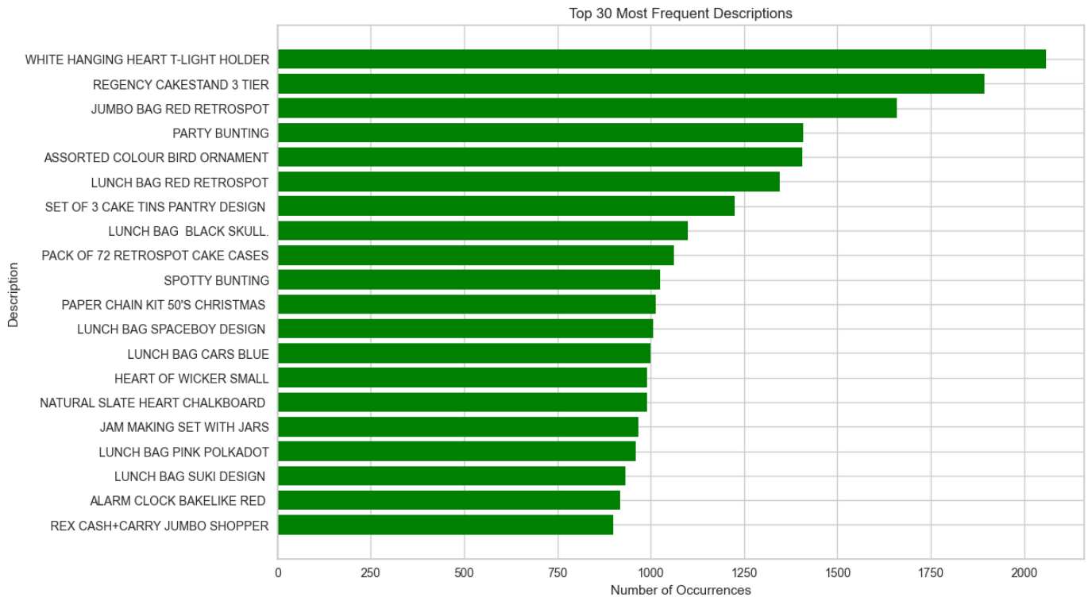
4.5 CLEANING DESCRIPTION COLUMN
Top 30 most frequent unique description in dataset.

Slide 23
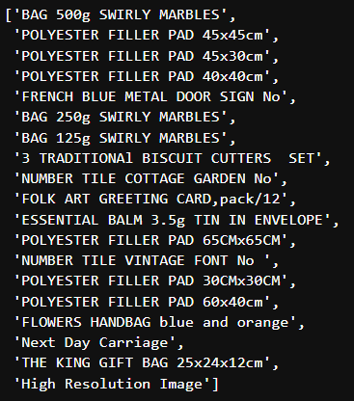
Descriptions containing lowercase characters
The descriptions that contain lowercase characters, it shows some non-product description,
such as "Next Day Carriage" and "High Resolution Image". Those seem to be unrelated to the
actual products

Slide 24
CLEANING DESCRIPTION strategy
Step 1 : Remove the rows where the descriptions contain non-product like "Next Day Carriage" and "High Resolution Image“.
Step 2 : For the remaining descriptions with mixed case, change to all uppercase. This will also assist in reducing the chances of having duplicate entries with different case styles.

Slide 25
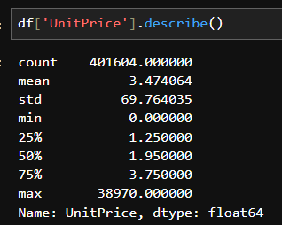
4.6 treating zero unit prices
Statistical “UnitPrice” column
The minimum unit price is zero. The transaction that contain zero price indicating a free item or a data entry error.
Including these transactions in the clustering analysis might introduce noise and cause distortion of distance which leading to incorrect cluster assignments.

Slide 26

Handling zero unit prices strategy
Remove the transactions that has the price that less than or equal to zero from the dataset
Which is essential for building an accurate and reliable clustering model and recommendation system.

Slide 27
Feature engineering
INTRODUCTION
DATASET OVERVIEW
EXPLORE DATA
DATA PREPROCESSING
FEATURE ENGINEERING
CORRELATION ANALYSIS
DIMENSIONALITY REDUCTION
MODELING
MODEL EVALUATION & ANALYSIS
RECOMMENDATION SYSTEM
5.1 RFM Model
5.2 Product Diversity
5.3 Behavioral Features
5.4 Geographic Features
5.5 Cancellation Insights
5.6 Seasonality & Trends

Slide 28
5.1 RFM MODEL
used to identify customer behavior based on 3 data such as Recency, Frequency, Monetary Value
Recency : the time since customer's last purchase. Shorter period = more interaction
Frequency : number of customer transaction
Monetary : total amount of money a customer has spent over a period

Slide 29
RECENCY
In this step, we focus on understanding how recently a customer has made a purchase.
Days Since Last Purchase : This feature represents the number of days that have passed since the customer's last purchase.
A lower value indicates that the customer has purchased recently, implying a higher engagement level with the business.
A higher value may indicate a lapse or decreased engagement.

Slide 30
frequency
In this step, we focus on feature that quantify the frequency of a customer's engagement with the retailer.
Total Transactions : represents the total number of transactions made by a customer. It helps in understanding the engagement level of a customer with the retailer.
Total Products Purchased : represents the total number of products (sum of quantities) purchased by a customer across all transactions. It gives an insight into the customer's buying behavior in terms of the volume of products purchased.

Slide 31
monetary
In this step, we focus on features that represent the monetary aspect of customer's transactions.
Total Spend : represents the total amount of money spent by each customer. It is calculated as the sum of the product of UnitPrice and Quantity for all transactions made by a customer.
helps in identifying the total revenue generated by each customer
Average Transaction Value : indicates the average value of a transaction carried out by a customer. This feature is calculated as the Total Spend divided by the Total Transactions for each customer.
understanding the spending behavior of customers

Slide 32
5.2 product diversity
In this step, we need to focus on the feature that:
understand the diversity in the product purchase behavior of customers.
understanding product diversity can help in crafting personalized marketing strategies and product recommendations
Unique Products Purchased: This feature represents the number of distinct products bought by a customer.
- A higher value indicates that the customer has a diverse taste or preference, buying a wide range of products
- A lower value might indicate a focused or specific preference.

Slide 33
5.3 Behavioral Features
In this step, we need to focus on the feature that:
Understand and capture the shopping patterns and behaviors of customers.
These features will give us insights into the customer's preferences regarding when they like to shop
Average Days Between Purchases : This feature represents the average number of days a customer waits before making another purchase.
this feature can help in predicting when the customer is likely to make their next purchase
Favorite Shopping Day : represent the day of the week when the customer shops the most
this feature can help in identifying the preferred shopping days of different customer segments
Favorite Shopping Hour : refers to the hour of the day when the customer shops the most.
identifying the favorite shopping hour can aid in optimizing the timing of marketing campaigns and promotions

Slide 34
5.4 Geographic Features
We will focus on a feature that reflects the geographical location of customers.
help us understand region-specific buying patterns and preferences.
After we analyze the ‘Country’ column, we observed that 89% of transaction comes from United Kingdom. Hence, we might consider creating a binary feature indicating whether the transaction is from the UK or not
Is_UK : indicate that whether that transaction is in UK or not

Slide 35
5.5 Cancellation Insights
In this step, we will going to dive deeper into the cancellation patterns of customers to gain insights that can enhance our customer segmentation model.
Cancellation Frequency: the total number of transactions a customer has canceled.
Cancellation Rate: the proportion of transactions that a customer has canceled out of all their transactions
gives a normalized view of cancellation behavior

Slide 36
5.6 Seasonality & Trends
In this step, we will focus on the seasonality and trends in customers' purchasing behaviors, which can offer insights for tailoring marketing strategies and enhancing customer satisfaction.
Monthly_Spending_Mean : This is the average amount a customer spends monthly.
indicate general spending habit of each customer
Monthly_Spending_Std : indicates the variability in a customer's monthly spending
example : a customer might generally spend a moderate amount each month, but occasionally, they make large purchases.
Spending_Trend : reflects the trend in a customer's spending over time, calculated as the slope of the linear trend line fitted to their spending data.
A positive value indicates an increasing trend in spending, possibly pointing to growing loyalty or satisfaction(vice versa).

Slide 37
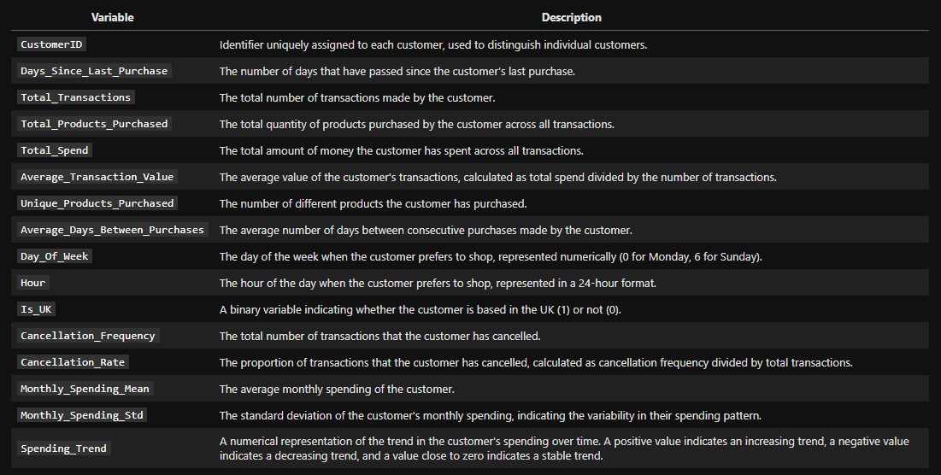
summary
We have total 16 features

Slide 38
CORRELATION ANALYSIS
INTRODUCTION
DATASET OVERVIEW
EXPLORE DATA
DATA PREPROCESSING
FEATURE ENGINEERING
CORRELATION ANALYSIS
DIMENSIONALITY REDUCTION
MODELING
MODEL EVALUATION & ANALYSIS
RECOMMENDATION SYSTEM

Slide 39
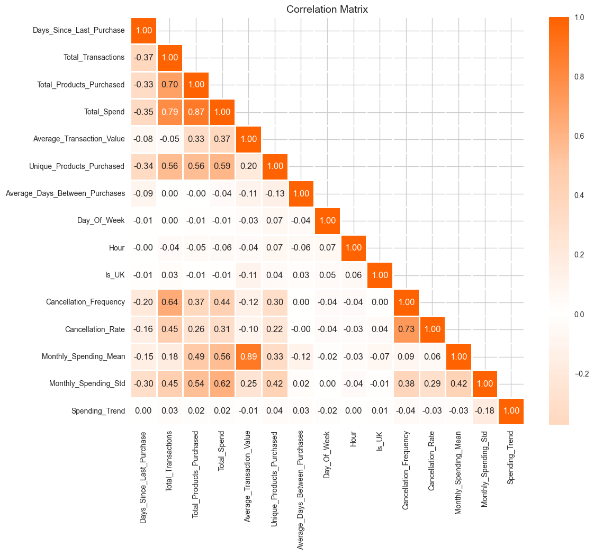
Features that highly correlated, can potentially affect the clustering process and not provide unique information (multicollinearity).
Which lead to clusters that are not well-separated and meaningful
We observe from above heatmap that there are some pairs of variables that have high correlations
Monthly_Spending_Mean and Average_Transaction_Value
Total_Spend and Total_Products_Purchased
Total_Transactions and Total_Spend
Cancellation_Rate and Cancellation_Frequency
Total_Transactions and Total_Products_Purchased

Slide 40
Dimensionality reduction
INTRODUCTION
DATASET OVERVIEW
EXPLORE DATA
DATA PREPROCESSING
FEATURE ENGINEERING
CORRELATION ANALYSIS
DIMENSIONALITY REDUCTION
MODELING
MODEL EVALUATION & ANALYSIS
RECOMMENDATION SYSTEM

Slide 41
Why We Need Dimensionality Reduction?
Remove Multicollinear Features :
help us remove redundant information
Noise Reduction :
focusing only on the most important features
Improved Computational Efficiency :
- Reducing the number of features can speed up the computation time during the modeling process

Slide 42
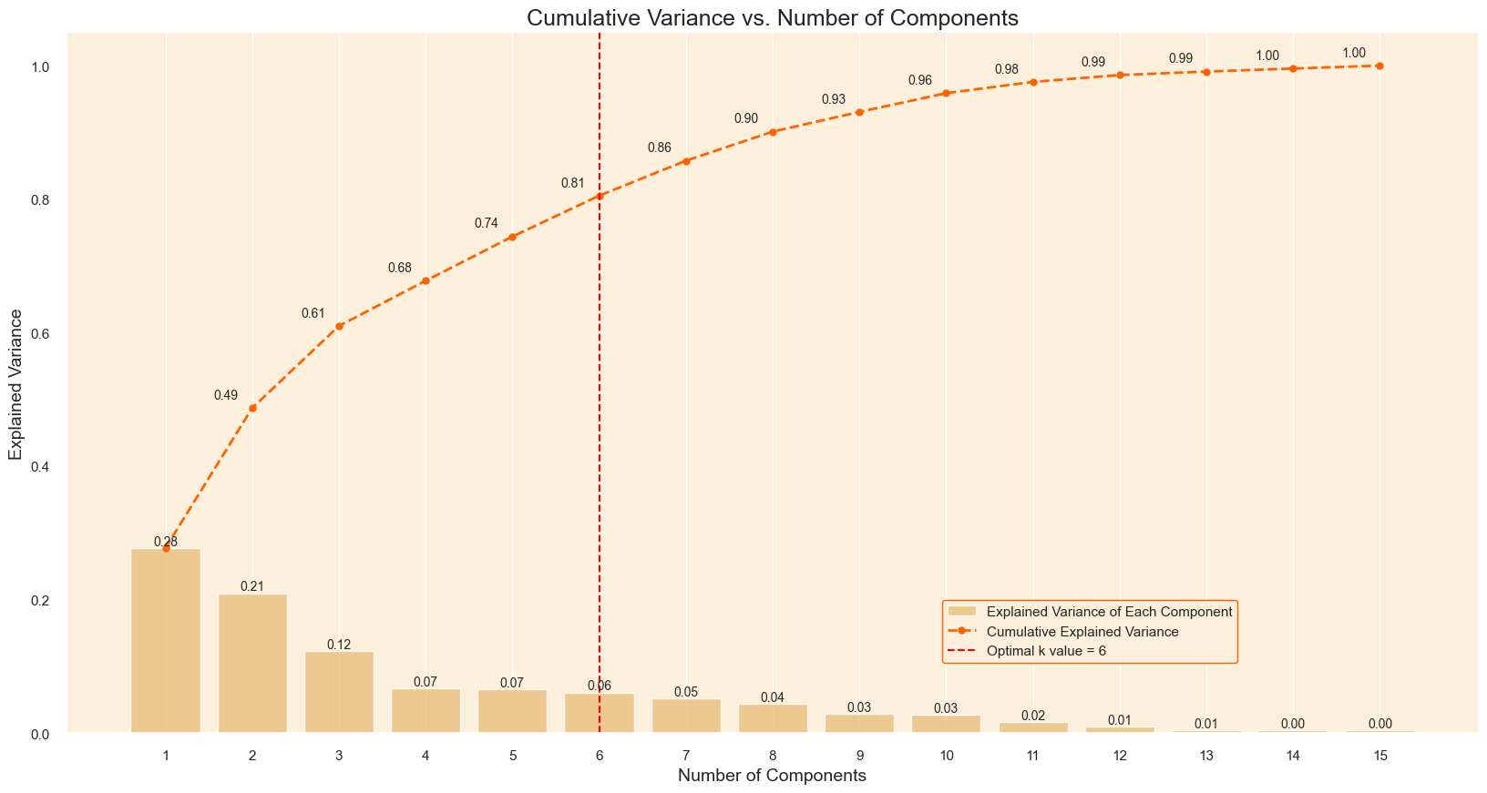
PCA (Principal Component Analysis)
Technique reduce the number of features in our dataset while still retaining a significant amount of the information.
Making our clustering analysis potentially more fast and accurate.
Strategy
Plot the cumulative variance in each feature.
Choose the n component that has cumulative variance higher than 80 percent of datasets
- That n component will be optimal number of PCs

Slide 43
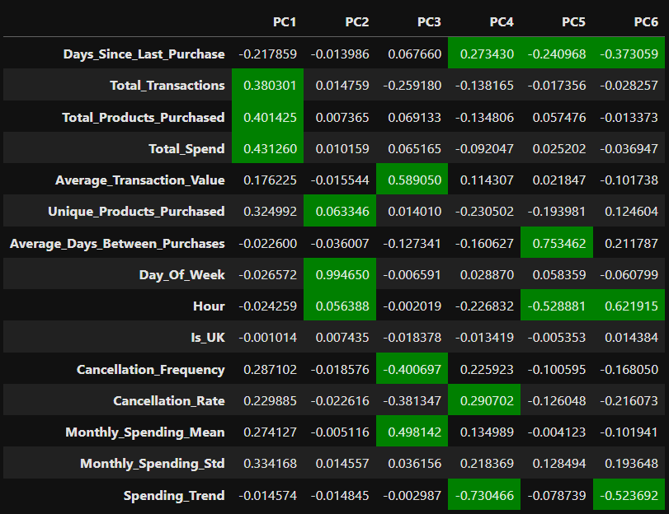
pca result
highlight the top 3 highest absolute values in each component, it helpful because it provides insights into which features are most influential in shaping the principal components.

Slide 44
modeling
INTRODUCTION
DATASET OVERVIEW
EXPLORE DATA
DATA PREPROCESSING
FEATURE ENGINEERING
CORRELATION ANALYSIS
DIMENSIONALITY REDUCTION
MODELING
MODEL EVALUATION & ANALYSIS
RECOMMENDATION SYSTEM
K-Means clustering
8.1 Determining the Optimal Number of Clusters
8.2 Clustering Model : K-means

Slide 45
K-means clustering
K-means clustering is unsupervised machine learning algorithm that is used to divide a given dataset into a predetermined number of clusters(k).
goal of k-means is to partition the data points into groups based on their feature similarities.
Before clustering the model, we use 2 method to determine optimal of clusters(k)
Elbow Method
Silhouette Method

Slide 46
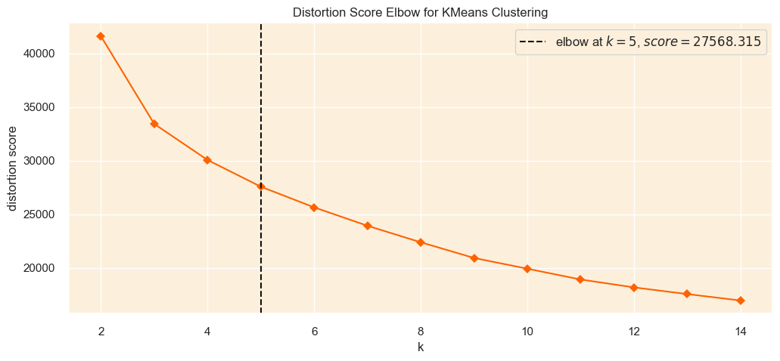
ELBOW Method
plotting the Within-Cluster Sum of Square (WCSS) or inertia against the number of clusters.
We observe that the suggested optimal k value is approximately 5. However, we don't have a very distinct elbow point in this case, but from our visualization indicating that the optimum value of k could be between 3 and 7.

Slide 47
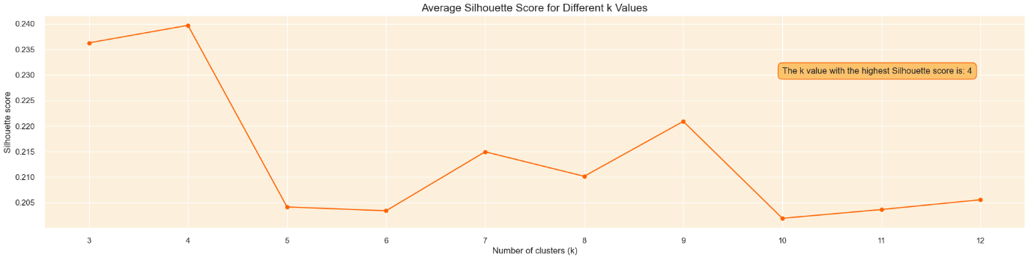
Silhouette Method
Measures how similar an object is to its own cluster compared to other clusters.
The score ranges from -1 to +1
high value indicates that the object is well matched to its own cluster, suggesting good clustering.
low value indicates that the object is differ to its own cluster, leading poor clustering.

Slide 48
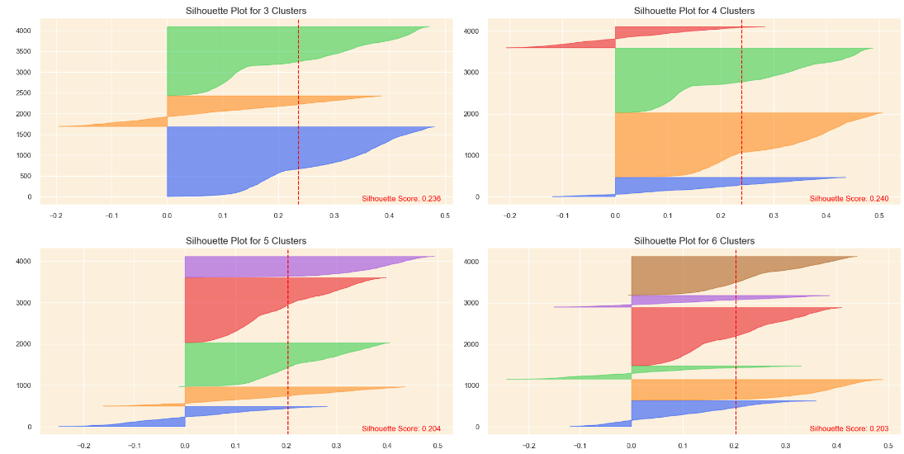
deeper analyze
From this silhouette plot, let analyst k=3 and k=4
3 Clusters (k = 3): You have only one cluster with a silhouette score below the average. This indicates that most clusters (2 out of 3) are performing well.
4 Clusters (k = 4) : Here, two clusters have scores below the average. This suggests a less consistent clustering performance across the board, with a higher proportion of clusters (2 out of 4) not performing as well.
Hence, we choose k = 3 as an optimal k

Slide 49
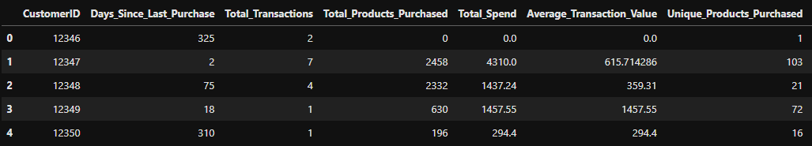
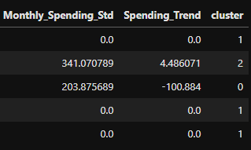
8.2 Clustering Model : K-means
After we get the optimal k from step 8.1, let’s build the clustering model.
Determine each customer is in what cluster.
…

Slide 50
MODEL EVALUATION
INTRODUCTION
DATASET OVERVIEW
EXPLORE DATA
DATA PREPROCESSING
FEATURE ENGINEERING
CORRELATION ANALYSIS
DIMENSIONALITY REDUCTION
MODELING
MODEL EVALUATION & ANALYSIS
RECOMMENDATION SYSTEM
3D Visualization of Top PCs
Cluster Distribution Visualization
Evaluation Metrics
Silhouette Score
Calinski Harabasz Score
Davies Bouldin Score

Slide 51
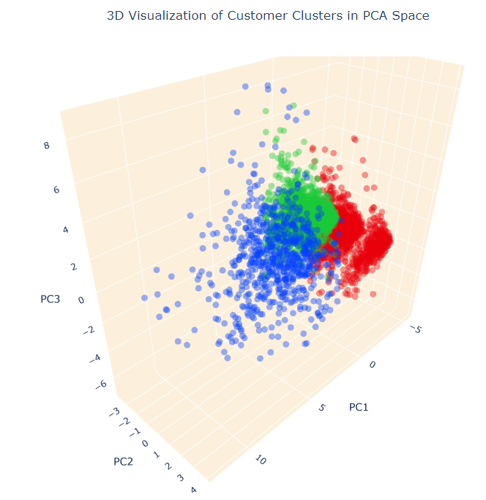
3D Visualization of Top PCs
Use a top 3 PCs (which capture the most variance in the data) and use them to create a 3D visualization.
This 3D visualization indicates that there are three distinct groups (clusters) of customers
each represented by a different color (red, green, blue)

Slide 52
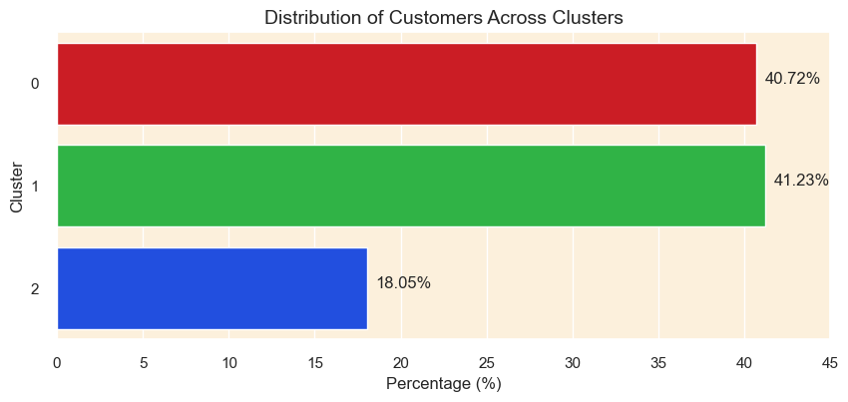
Cluster Distribution Visualization
Clusters 0 and 1 holding around 41% of customers each and cluster 2 is approximately 18% of the customers. Considered fairly balanced distribution.
No cluster contains very small percentage of customers, ensure that there is no outlier or noise in the data.

Slide 53
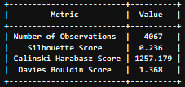
Evaluation Metrics
The Silhouette Score of 0.236, although not close to 1, it still fair amount of separation between the clusters and indicates reasonable structure.
The Calinski Harabasz Score of 1257.179, which is considerably high, indicating that the clusters are well-defined.
The Davies Bouldin Score of 1.368 is considered low, which is reasonable because the fair score of Silhouette Score and high score of Calinski Harabasz Score.

Slide 54
MODEL ANALYSIS
INTRODUCTION
DATASET OVERVIEW
EXPLORE DATA
DATA PREPROCESSING
FEATURE ENGINEERING
CORRELATION ANALYSIS
DIMENSIONALITY REDUCTION
MODELING
MODEL EVALUATION & ANALYSIS
RECOMMENDATION SYSTEM
Identify the behavior of each customer from the radar chart.

Slide 55
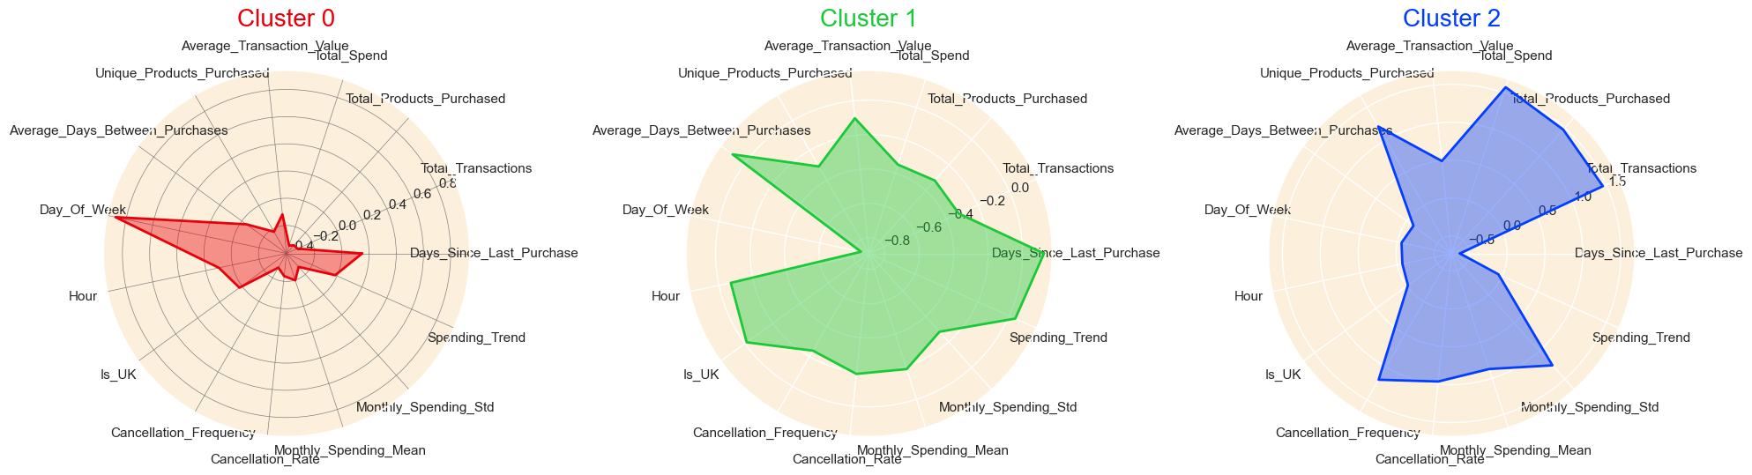
Radar Chart Approach
Cluster 0
Customers in this cluster tend to spend less (low monthly_Spending_Mean).
They loves to buy in weekend (due to very high Day_of_Week value).
They spending behavior are stable (low Monthly_Spending_Std).
They have a slight tendency to shop during the weekends.
Weekend Shopping Customers
Cluster 1
Customers in this cluster show a moderate level of spending
their transactions are not very frequent, as indicated by the high Days_Since_Last_Purchase and Average_Days_Between_Purchases.
They have a very high spending trend, indicating that their spending has been increasing over time.
They are not frequent big spenders with a high spending tren
Infrequent Big Spenders with a High Spending Trend Customers

Slide 56
Radar Chart Approach
Cluster 2
Customers in this cluster are high spenders with a very high total spend.
have a high cancellation frequency.
They are frequent high-spenders with a high rate of cancellation
Frequent High-Spenders with a High Rate of Cancellations Customers

Slide 57
RECOMMENDATION SYSTEM
INTRODUCTION
DATASET OVERVIEW
EXPLORE DATA
DATA PREPROCESSING
FEATURE ENGINEERING
CORRELATION ANALYSIS
DIMENSIONALITY REDUCTION
MODELING
MODEL EVALUATION & ANALYSIS
RECOMMENDATION SYSTEM

Slide 58
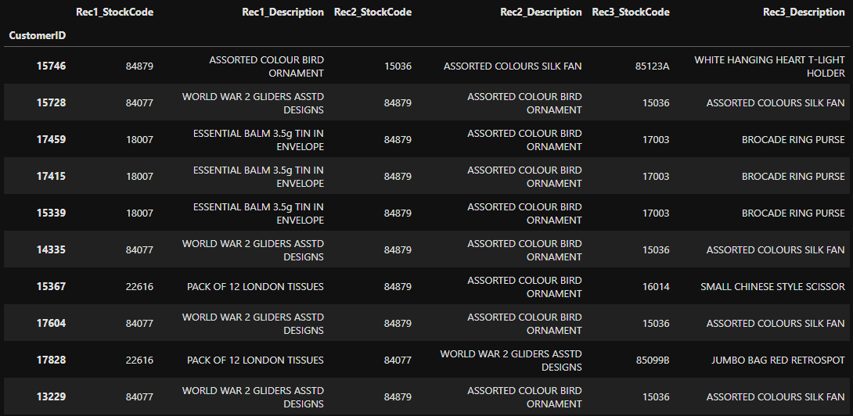
FINAL RESULT

